Slide 1
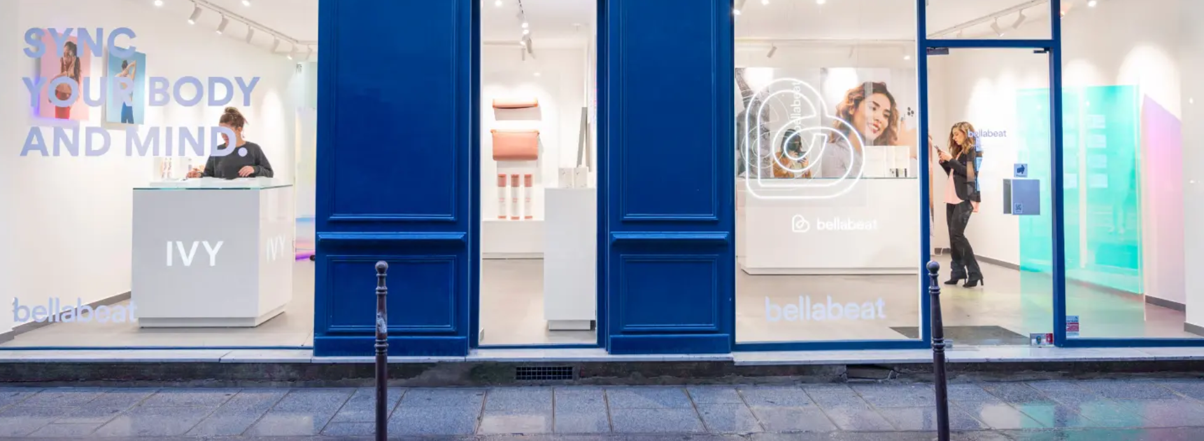
Bellabeat Smart Device Data Analysis Case Study
Rajiv G.
09/17/2025
Bellabeat Case Study Overview

Slide 2
Overview of Bellabeat and Its Mission
Overview of Bellabeat and Its Mission
Bellabeat: A pioneering femtech company founded in 2014 by Urška Sršen and Sandro Mur.
Products: Smart wellness devices for women, including the Leaf tracker, Ivy wearable, Spring water bottle, and the Bellabeat app.
Mission: Empower women with actionable health insights through beautifully designed technology.

Slide 3
Stakeholders
Key Individuals and Groups Involved
Urška Sršen: Cofounder and CCO of Bellabeat.
Sandro Mur: Cofounder and key member of the Bellabeat executive team.
Marketing Analytics Team: Responsible for analyzing consumer data to guide Bellabeat’s marketing strategy.
Customers: Female users of Bellabeat products who provide valuable data on device usage.

Slide 4
Business Task
Problem Statement and Focus
Task: Identify major trends in smart device usage and propose strategies to enhance engagement with Bellabeat’s products.
Stakeholders: Bellabeat executive team, marketing analytics team, and potential female customers.
Guiding Questions:
What trends are present in smart device usage?
How do these trends relate to Bellabeat's target customers?
How can these insights guide Bellabeat's marketing strategy?

Slide 5
Data Sources
Data for Analysis
Primary Source: Fitbit Fitness Tracker Dataset (public domain). Includes minute-level activity, sleep, and heart rate data from 30 users.
Data Storage: Stored in CSV files, imported using SQL and R Studio for analysis.
Bias & Credibility: Sample size and public source limitations were considered during the data review.

Slide 6
Data Cleaning & Preparation
Cleaning & Preparing the Data for Analysis
Error Identification: Detected and cleaned errors and missing values using SQL filtering and R scripts.
Data Merging: Unified date fields and merged datasets where necessary.
Aggregation: Used SQL GROUP BY and R's dplyr to aggregate data from minute-level to daily summaries.
Documentation: All cleaning steps were documented for reproducibility and transparency.

Slide 7
Data Analysis
Exploring the Data
Patterns Explored:
Daily steps, active minutes, sedentary time, and sleep hours.
Correlated activity intensity with sleep quality: More active minutes led to longer and better sleep.
Dips in activity observed on weekends; key engagement times were identified.
Tools Used:
BigQuery for data aggregation and joins.
R for exploratory analysis and visualizations (box plots, line charts).

Slide 8
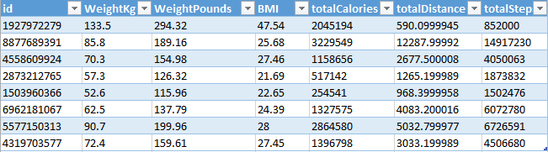
Analysis using BigQuery
WITH RankedWeightInfo AS (
SELECT id, WeightKg, WeightPounds, BMI, ROW_NUMBER() OVER (PARTITION BY id ORDER BY WeightKg DESC) AS topWeight
FROM my-coursera-project.case_study_test_Data.weightLogInfo)
SELECT wlog.id, wlog.WeightKg, wlog.WeightPounds, wlog.BMI,
SUM(dc.Calories) AS totalCalories, SUM(da.TotalDistance) AS totalDistance,
SUM(da.TotalSteps) AS totalSteps
FROM RankedWeightInfo AS wlog
JOIN `my-coursera-project.case_study_test_Data.dailyCalories` AS dc ON dc.id = wlog.Id
JOIN `my-coursera-project.case_study_test_Data.dailyActivity` AS da ON da.Id = dc.Id
WHERE wlog.topWeight = 1 AND dc.Calories > 2000
GROUP BY wlog.Id, wlog.WeightKg, wlog.WeightPounds, wlog.BMI;

Slide 9
Findings & Visualizations
Key Insights and Visualizations
Activity Trends: Time series line charts showing daily activity patterns.
Activity vs. Sleep: Scatter plot illustrating the correlation between activity intensity and sleep quality.
Weekly Trends: Bar charts highlighting dips in activity over weekends.
Visualization Tools:
R (ggplot2), Google Sheets, Tableau for visualization.
Summary of Insights:
Active users tend to have better sleep quality.
Weekends see a dip in activity; this is an opportunity for targeted engagement.
Personalized recommendations could drive product usage.

Slide 10
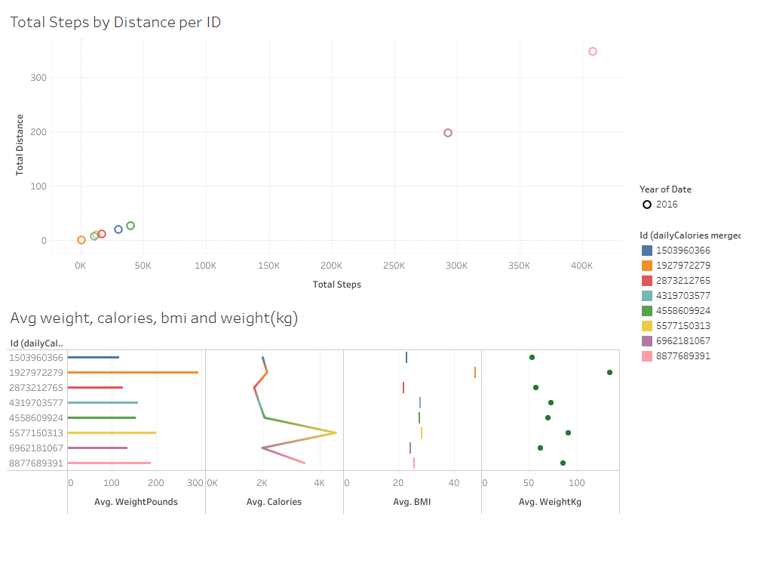
Analysis using Tableau

Slide 11
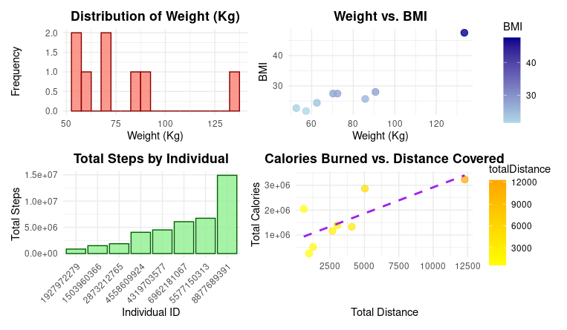
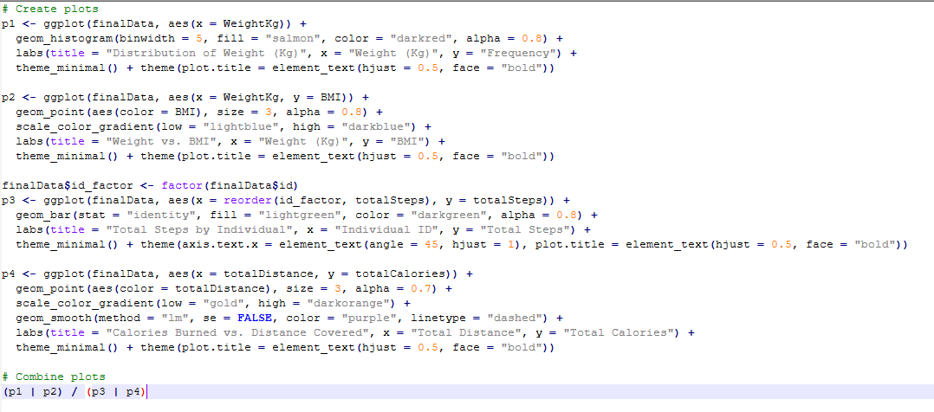
Analysis using Rstudio

Slide 12
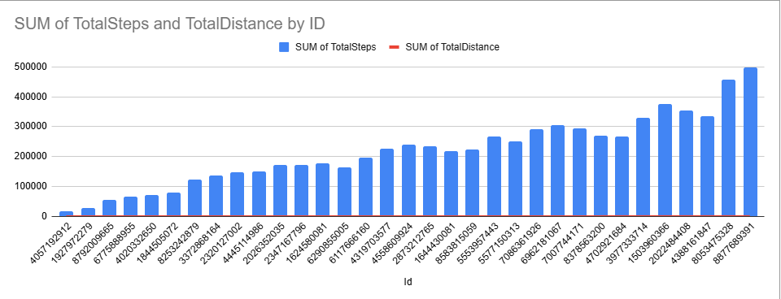
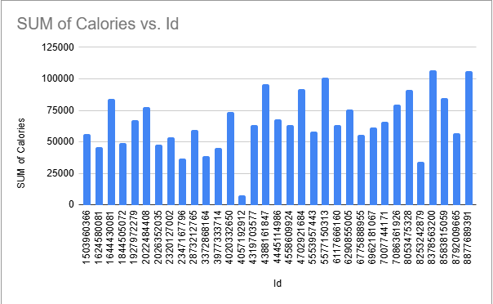
Analysis using Google sheets
Analysis using Excel chart

Slide 13
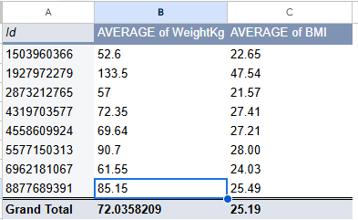
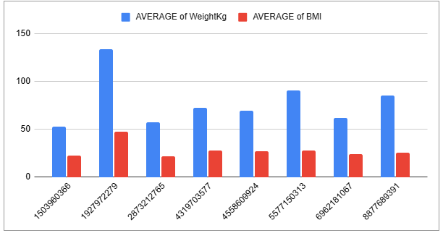
Analysis using Excel Pivot

Slide 14
Recommendations
High-Level Marketing Strategies
Encourage Consistent Weekly Activity: Target campaigns to increase engagement over weekends.
Promote the Link Between Activity and Sleep: Focus on messaging that highlights the benefits of an active lifestyle for better sleep quality.
Personalize App Features & Marketing: Leverage user behavior and biometric data to personalize content and marketing messages.
Expand Data Collection: Gather additional data for more detailed, personalized strategies.

Slide 15
Conclusion & Next Steps
Summary and Action Plan
Conclusion: Analyzing smart device usage trends provides actionable insights for improving product marketing, optimizing campaign timing, and enhancing customer retention.
Next Steps:
Implement Targeted Campaigns: Use the insights to develop data-backed marketing campaigns.
Enhance App Personalization: Continue personalizing the Bellabeat app for better user engagement.
Ongoing Analysis: Regularly analyze new data to refine strategies and adapt to evolving trends.

Slide 16

Contact Info:

